Slide 1


Faculty of Engineering
University of Ruhuna
YOLO
UNIFIED, REAL-TIME OBJECT DETECTION
Conference Paper By :
Joseph Redmon, Santosh Divvala, Ross Girshick, Ali Farhadi (CVPR 2016)

Slide 2

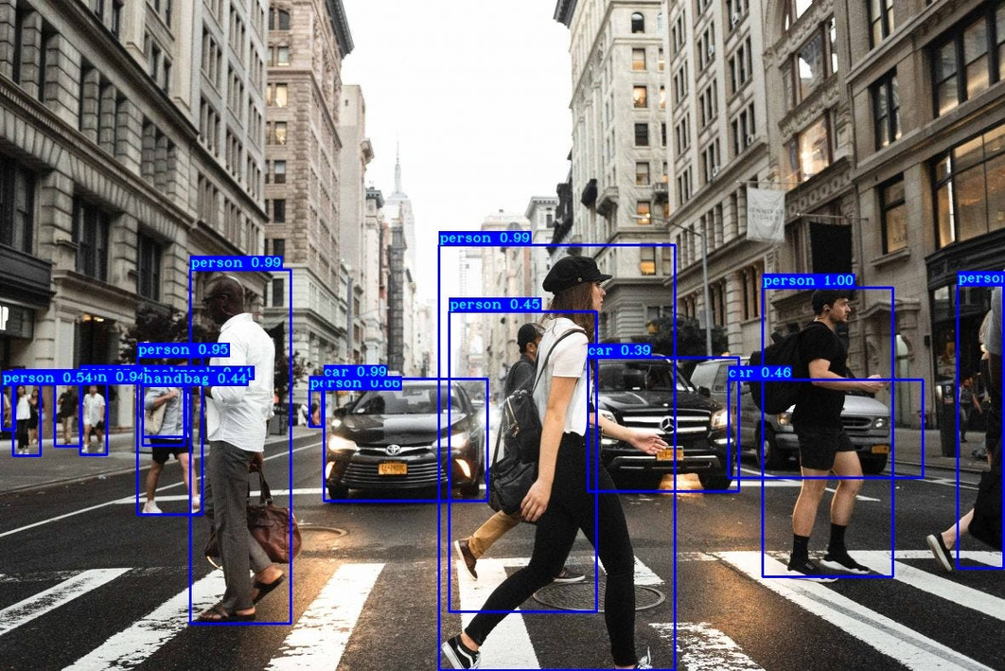
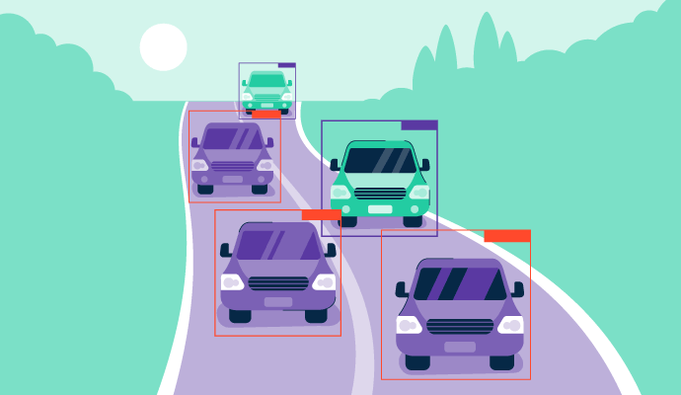
THE CHALLENGE OF OBJECT DETECTION
  Object detection identifies what and where things are in an image.
  Traditional methods (e.g., R-CNN, DPM) use multiple stages – region proposals, classification, and bounding box refinement.
  These pipelines are slow and complex, limiting real-time performance.
  Goal: Develop a fast, unified model that detects objects in real-time using a single neural network.
Key Idea: “You Only Look Once” – detect everything in one pass.

Slide 3
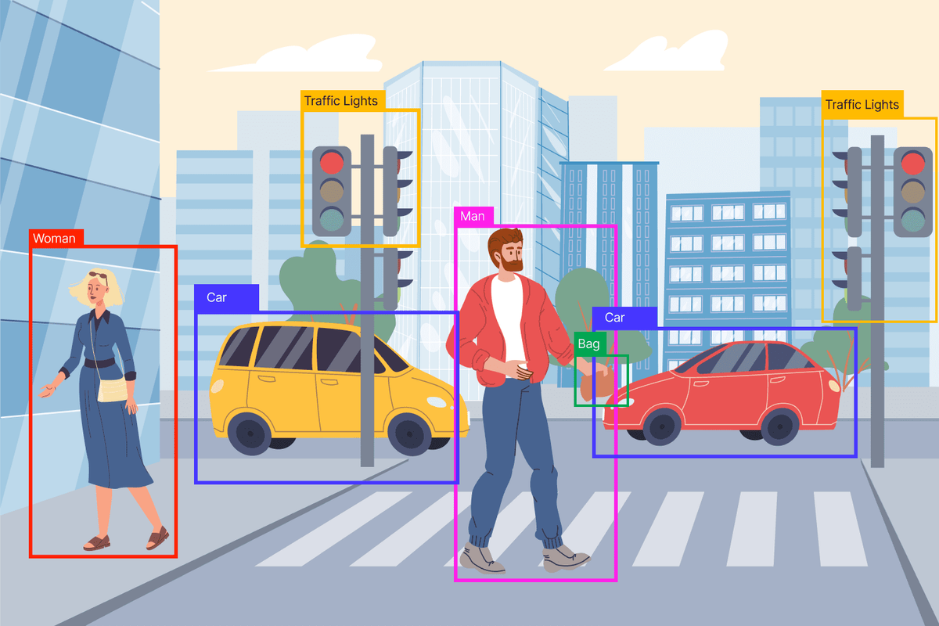
EVOLUTION OF OBJECT DETECTION
  DPM (Deformable Parts Model): Uses sliding windows; accurate but slow.
  R-CNN → Region proposals + CNN + SVM (40 sec/image)
  Fast R-CNN → Shared computation, but still needs region proposals.
  Faster R-CNN → Region Proposal Network (7 FPS).
  These methods rely on multi-stage pipelines and local reasoning.

Slide 4
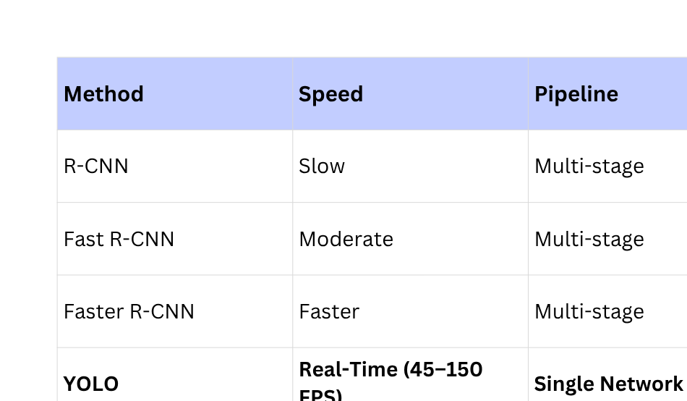
YOLO VS PREVIOUS METHODS
YOLO reframes detection as a single regression problem from image
pixels → bounding boxes + class probabilities.

Slide 5
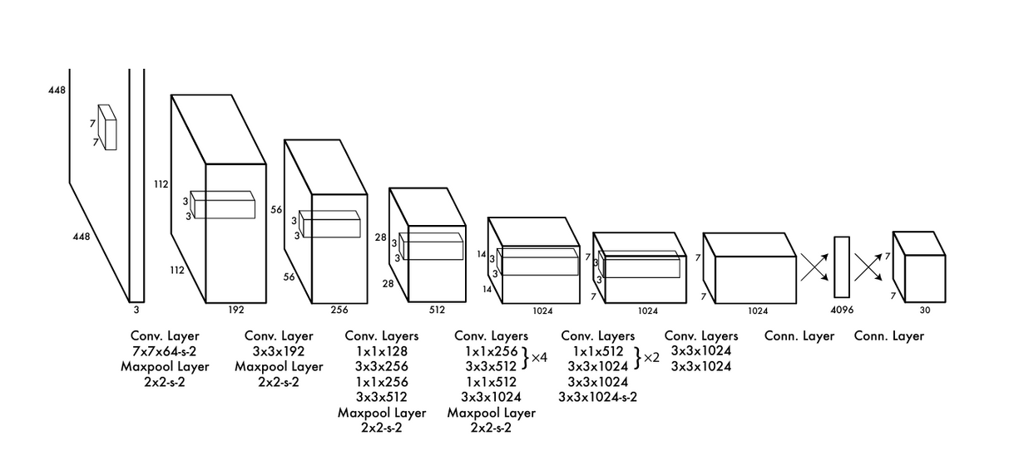
YOLO MODEL OVERVIEW
  Input image divided into S × S grid (S=7).
  Each cell predicts:
    B bounding boxes (B=2)
    Confidence scores
    C class probabilities (C=20 for PASCAL VOC)
  Output: 7 × 7 × 30 tensor → class & location predictions.
The Architecture

Slide 6
NETWORK ARCHITECTURE
  24 convolutional + 2 fully connected layers
  Inspired by GoogLeNet but simplified (uses 1×1 and 3×3 conv layers).
  Trained on ImageNet, fine-tuned for detection (448×448 images)
  Loss Function: Sum-squared error with weighting for
    Localization (λcoord = 5)
    No-object confidence (λnoobj = 0.5)
  Activation: Leaky ReL

Slide 7
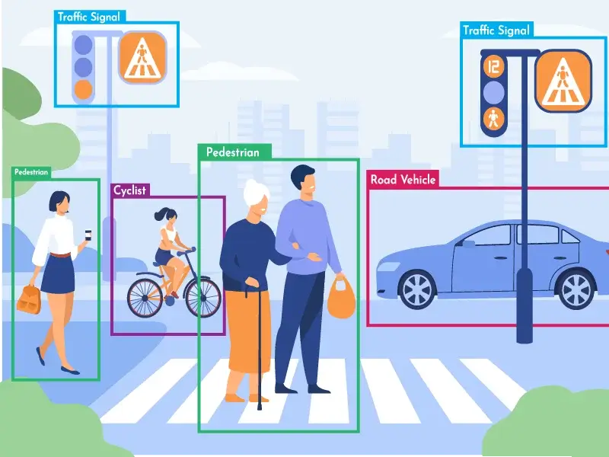
TRAINING & INFERENCE
  Training:
    135 epochs on PASCAL VOC 2007+2012
    Data augmentation (scaling, translation, color shift)
  Inference:
    One forward pass → 98 boxes/image
    Non-Max Suppression removes duplicates
  Fast YOLO: Smaller network (9 conv layers), 155 FPS.

Slide 8
REAL-TIME DETECTION RESULTS
Detector | mAP | FPS
100Hz DPM | 16.0 | 100
Fast YOLO | 52.7 | 155
YOLO | 63.4 | 45
Faster R-CNN | 73.2 | 7
YOLO achieves real-time speed with competitive accuracy.

Slide 9
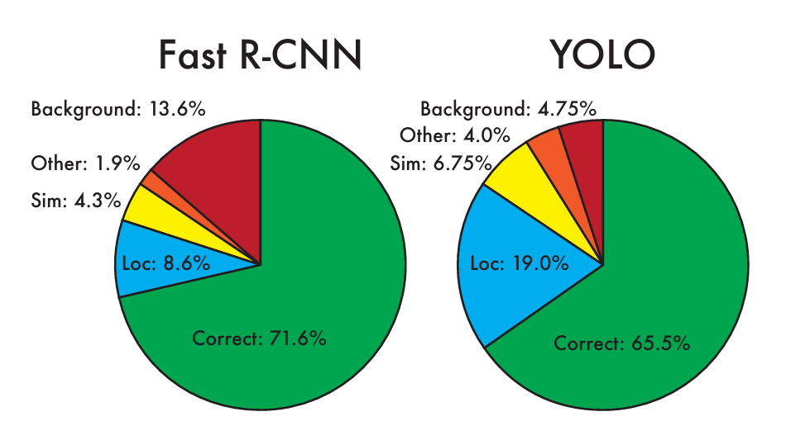
ERROR ANALYSIS
  YOLO makes fewer background (false positive) errors.
  Main weakness: Localization errors (inaccurate bounding boxes).
  Combining YOLO + Fast R-CNN improves mAP from 71.8 → 75.0%.
ErrorAnalysis: FastR-CNNvs. YOLO

Slide 10
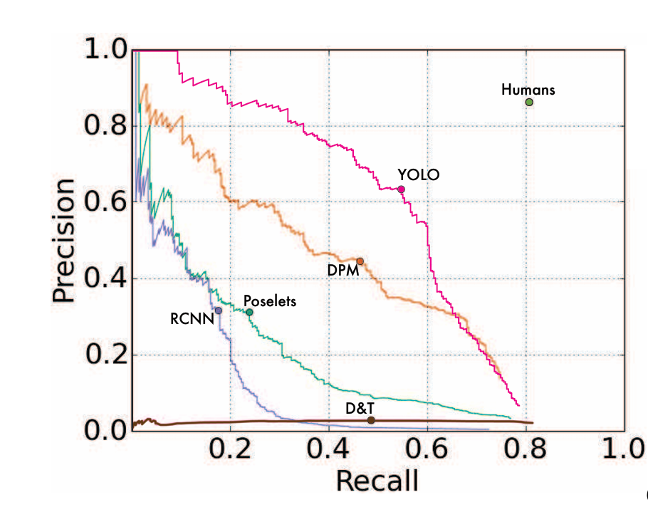
GENERALIZATION TO NEW DOMAINS
  Tested on artwork datasets (Picasso, People-Art).
  YOLO performs better than R-CNN and DPM.
  Shows strong generalization ability across visual styles.
Generalization results on Picasso

Slide 11
CONCLUSION & FUTURE WORK
Achievements:
  Introduced unified detection framework – single CNN, real-time speed.
  Improved generalization beyond natural images.
Limitations:
  Struggles with small and overlapping objects.
Future Work:
  Improve localization accuracy.
  Refine model for small object detection.
  Extend to multi-scale detection (→ YOLOv2, v3, v4, YOLOv5+).

Slide 12
THANK
YOU
Presented By :
Dissanayake D.K.R.C.K - EG/2020/3910
Samaraweera R.P.R.T.N - EG/2020/4180
Weerasinghe L.W.S.T. - EG/2020/4271
Wickramage W.D.M. - EG/2020/4278

